Slide 1
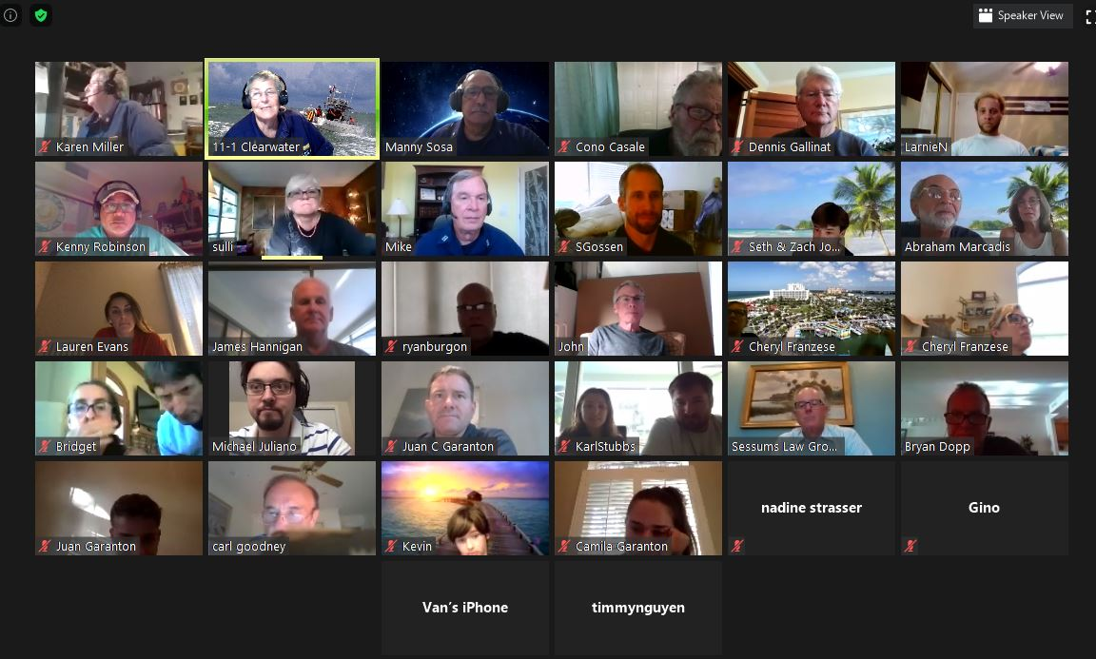
Kick-Starting Video Public Education Classes
1
Notes:
This is designed to be a step-by-step reference tool for quickly and efficiently setting up and holding your flotilla’s virtual video Public Education Classes.
Video conferencing offers the FSO-PE the ability to see, hear, speak and chat simultaneously with all the students in a class of 49 or less.
Zoom offers HD video, audio, collaboration/education, and chat simultaneously.
This might not be a physical classroom, but we can make it a “virtual” class with the use of video.
We all know that “A picture is worth a thousand words.”
We can use video to carry out our mission of recreational boating safety by effectively teaching safe boating to the public.
Flotillas that generate revenue from public education can generate substantial funds to carry out their missions for the US Coast Guard.
Disclaimer: This whole presentation is based on the Zoom videoconferencing platform. The authors do not have any connection, monetary or otherwise, with Zoom other than they have tested and used many different videoconferencing platforms and Zoom appears to meet best the goals of virtual PE classes at this time.

Slide 2
Course Objectives
Why conduct video classes
Cover nuts and bolts of video classes
Market/
Sales
Register/
Payment
Class/
Test
Survey/
Cross-sell
Recruit/
Retain
Member/
Officer
Notes:
This slide shows a conceptual model for flotilla growth based on our ability to systematically deliver PE classes …
We start with the classes for expediency and add modules as we can to carry out these functions, eventually creating a self-renewing circle of activities.
This presentation will generally follow this circular, perpetual model.

Slide 3
Three Sections
Rationale and logistics of virtual classes
Zoom – the basics
Marketing USCG Auxiliary Public Education classes
Notes:
To appeal to the highest number of Auxiliarists, especially at the flotilla level of both FSO-PEs and elected bridge, to implement virtual Public Education classes, this presentation is divided into three sections.
Section one explains the whys and wherefores of offering classes – it’s essentially a blueprint to conducting PE classes via a videoconference platform. In this case, Zoom.
Section two is useful for both virtual and in-person classes. It provides substantial ideas and examples to market the Auxiliary classes through numerous channels.
Section three covers the six steps to implement a Zoom delivery system at the flotilla or division level.

Slide 4
Effective Market Reach
Face to Face Class
Online self-study (generic)
Video class with
Auxiliary Instructors
Notes:
Face to Face is limited by classroom size, transportation, ability to obtain free or rent space, parking, facilities, projector, electricity, Wi-Fi , comfortable seating, ability to break for lunch, and other physical and logistical factors.
Online self-study will likely appeal to those people who want to comply with state boating requirements and are not not likely to attract boaters interested in learning,
Video classes are likely to attract, both, boaters interested in learning, safety, etc. and those wanting to comply with state boating requirements as well as rental companies. They are limited only by the need to have audio and webcam. That means we can effectively reach boaters virtually within our states; bringing the benefit of CG Auxiliary knowledge and skills to our state boaters in unprecedented numbers. And, flotillas can greatly strengthen their financial resources to support its multiple missions.

Slide 5
KEY THOUGHTS…
Video class not a webinar
Attract new students
Reach remote locations
Expand offerings state-wide to reach many more boaters
Open new relationships with boating entities to refer students
Greatly enhance the quality of student learning
Simplify logistics
Progress and grow continuously

Slide 6
Before Getting Underway
Schedule Classes
Weekends?
Weekdays?
Weeknights?
Combination?
Suggestion: Maximum of two hours at a time with a short break
Determine maximum class size
Notes:
Lead Instructor; Aide; Guest Observer
Schedule: dates, times, breaks
Student capacity: start 20 – 25; cap 40 – 49
Registration & Platform: Zoom
Test: Google Drive
Survey: Survey Monkey or Google Forms
Gallery ~ Shared Screen ~ Chat
One full day or two half-days like a classroom with ten minutes breaks every hour
Four consecutive M – Th. 90 minute evening sessions
Two weekends two hour each Sat. Sun.
Try alternative class formats depending upon your instructors and the ability of students to learn; closer is better than too spread out.

Slide 7
Market Your Class
Add class to 7023
Advertise
Pent up demand?
Local press?
Flotilla Website?
Flotilla Facebook Page?
Craig’s List?
Nextdoor?
Eventbrite?

Slide 8
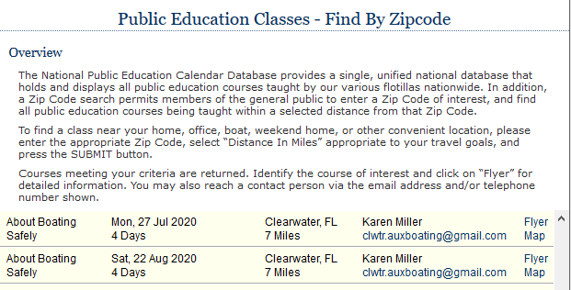
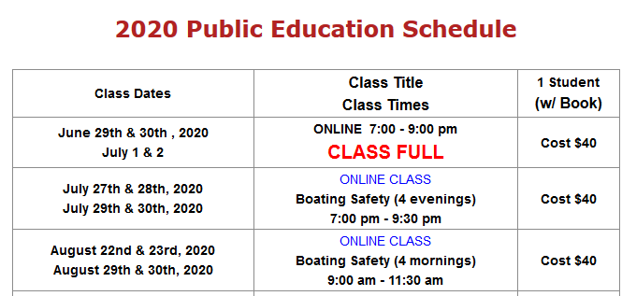
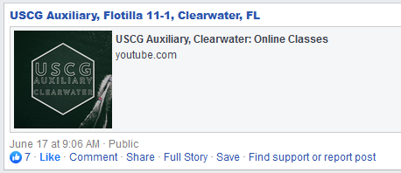
Market Your Class
11-1 YouTube

Slide 9
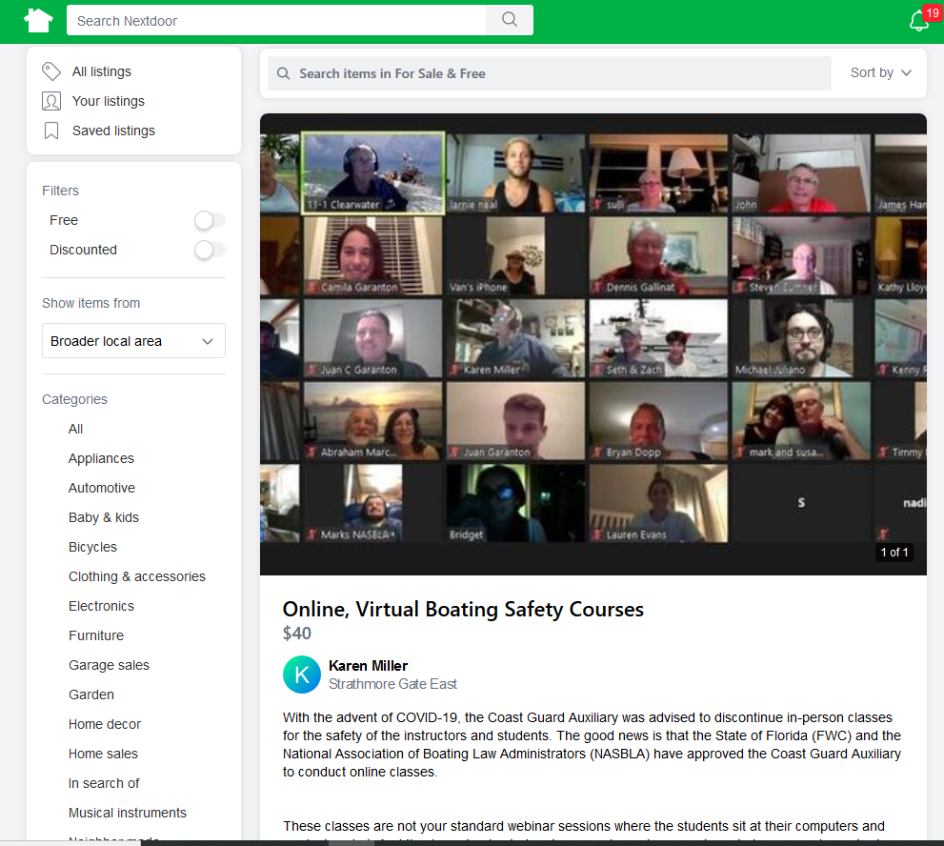
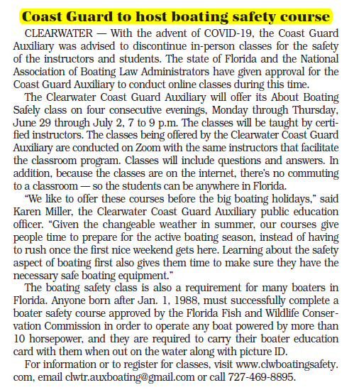
Market Your Class

Slide 10
Market Your Class
Position Your Video Class
Interactive with the same great Auxiliary instructors
No need to travel; convenience of home
Save time, round-trip, costs, parking
Safe environment for learning
All inclusive leading to state certification

Slide 11
Register Your Students
Collect Course Fees
PayPal
Square
Checks
Remind students of minimum audio/visual requirements

Slide 12
Get Materials to Students
Mail out books and supplemental material to the students
Leave enough time for media mail
Track to make sure material delivered
Order manila envelopes and stamps from ANSC via FSO-MA
Notes:
Getting the class book and additional materials (Federal Regulations; Florida Laws; ATON brochures; etc., etc.) out to the students might be the most tedious aspect of conducting virtual classes, but it’s totally doable.
Give yourself enough time to get large manila envelopes and stamps from ANSC through your FSO-MA. Make sure to justify the large order since it exceeds normal quantities. Media mail for two pounds for “local” mail is currently $3.33 as media mail – this covers one book and lots of supplemental material. The District 7 DSO-FN has confirmed that this is a legitimate use of government stamps. And, ANSC has willingly shipped the envelopes and stamps.
Since media mail is really “snail” mail, plan on getting the books out at least a week ahead of the start of the class. Since each mailing gets a tracking number, you can even confirm that the student has received the books.

Slide 13
Instructors
Schedule instructors
Conduct training sessions
How to instruct using video technology
How to use technology correctly
Instill proper mindset
Practice
Assign co-hosts and practice some more
Assign uniform of the day
Notes:
Solicit instructors who are willing to try teaching with this new technology. It’s different, but the opportunities to learn something new will be exciting to some of your instructors.
If some of your instructors are familiar with using Zoom or another platform to teach (not just as a Friday social hour or family virtual get together), they would be ideal to recruit for these classes.
One of the very helpful aspects of Zoom is the ability to assign co-hosts. The co-host feature allows the host to share hosting privileges with another user or users, allowing the co-host to manage the administrative side of the meeting, such as managing participants or starting/stopping the recording.
Remember to determine the uniform of the day for the classes. The Auxiliary Manual states that the normal uniform is Tropical Blue, but some flotillas conduct their classes in Operational Dress Uniforms (ODUs).
The next slides will cover the really important pre-class training/practice session.

Slide 14
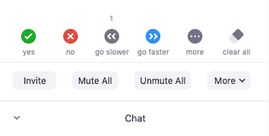
Familiarize/Practice Controls
Screen: Full, Gallery, Speaker
Notes:
This slide has a hyperlink to a Zoom video on using some of the features. Watch it on your own time at a later date.
Time to Play…
Set up a test meeting with Co-host for the first time.
Set up someone else as a Co-Host at the start; this comes in very handy if the Host loses electricity or Wi-Fi.
Practice controls.
Do a full dry run.
Bring out main controls from bottom or top of screen by hovering the mouse.
Hover the mouse over each symbol to see drop down/drop up menus; click and explore how each one works.
***Access to controls depends upon number of participants and to whom rights have been given*** Zoom is unusually flexible in that it allows simultaneous access.

Slide 15
Test Run with Instructors
Mindset
Let the instructors share their concerns with you so you can address them in the test run, not later at the class
Use Gallery as much as possible to simulate classroom
Use humor and good nature to bring out a caring environment
Be encouraging of Q & A as well as bringing out student’s interests in taking the class
Do not read the PPT; use it to illustrate
Positive interaction with boaters to help them to boat safely
Wrap up feeling that you are helping the boaters
Uniforms of the Day

Slide 16
Test Run with Instructors
Technical
Co-Host(s) - Controls review and practice.
While welcoming, get participants comfortable with the key six controls:
Screen: Gallery/Speaker/Maximize Buttons
Mute/unmute button
On/off video button; virtual background
Participants and chat choices buttons
Non-verbal cues buttons; pin video button
Rename capability
Practice Share Screen thoroughly
Documents/folders preparation for class
YouTube and any Internet hyperlinks
Notes:
Slide 20 covers this again

Slide 17
Test Run with Instructors
Netiquette
Discuss and agree in advance
Test
Review test
Systems
Observe someone else’s class first if you can
Be thinking throughout how you would apply to your class

Slide 18
Classes
Start the class session early
At least 45 minutes for instructors
Set up co-hosts
Consider setting up second computer via hotspot
Check instructors’ lighting
Make sure background is sanitized / use Zoom background
Notes:
Set up an hour early
Instructors check in 45 – 60 minutes early
Set up co-hosts; hot spot; second computer; second camera
Remind co-host to monitor chat…
Check front lighting (no back lights) and background
Open all folders/files that will be used
Check Internet sites that will be used

Slide 19
Classes
Start the class session early
At least 30 minutes for students
Get the kinks out of any connections
Information passing
Welcome / Develop rapport
Run info slides while everyone is signing on first time
Notes:
Open 30 early for students (previously advised at registration and/or meeting invitation)
Welcome each one
Confirm registration information
Develop rapport; why the class; boating experience; boats owned

Slide 20
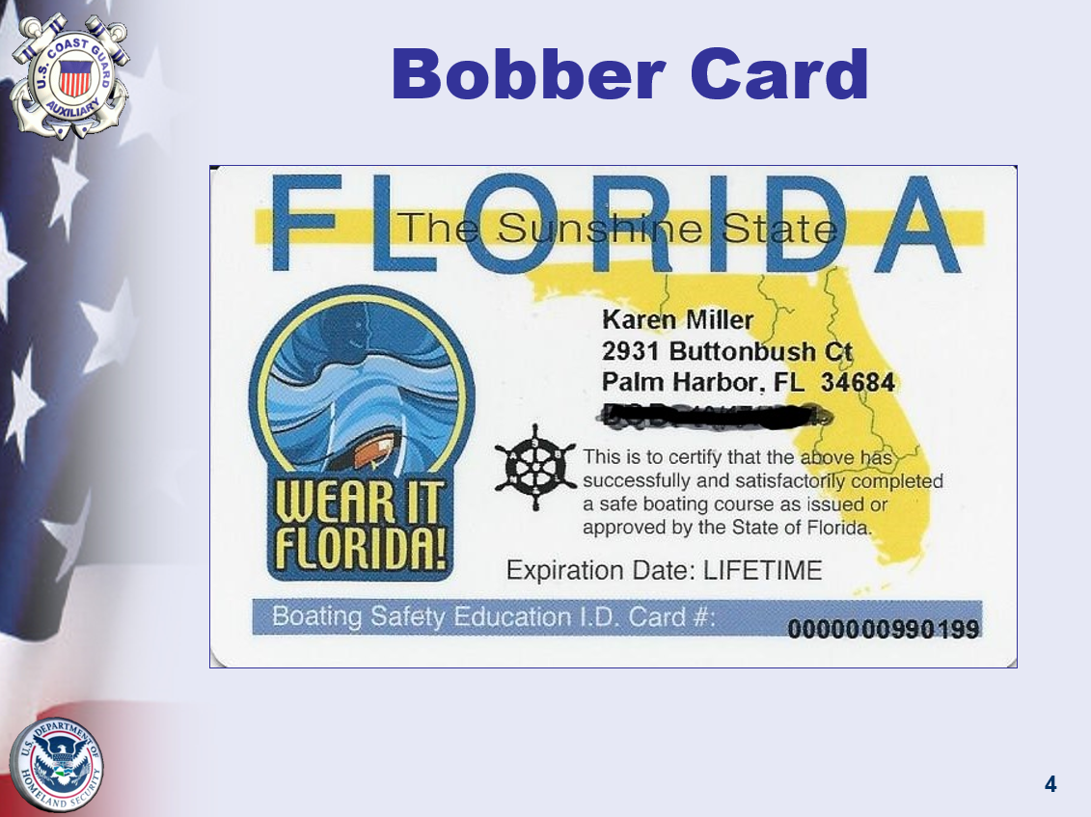
Classes
Notes:
This is a sample PPT show that runs while the students sign up for the first time. It’s on a timer so it keeps repeating while they’re getting connected.
Remember to take it down regularly to let the students see the gallery view

Slide 21
Six Key Controls and Gallery View
Get them to play with Six Key Controls, not just tell them about them.
Screen: Gallery/Speaker/Maximize buttons
Mute/unmute button
On/off video button; virtual background
Participants and chat choices buttons
Non-verbal cues buttons; pin video button
Rename capability
Ask them each to deploy Gallery view
Play with virtual background

Slide 22
Netiquette
Introduce all instructors; their roles
Explain efforts to create friendly class atmosphere by keeping buttons unmuted and videos on to see, hear, speak and chat with each other
(Only mute if too much background noise)
If disconnected, log in again
Welcome to participate
Encourage asking questions during the chapter rather than hold to the end
Suggest fun of using non-verbal buttons

Slide 23
Introduction
Agenda, schedule, breaks
Explain approach to the class and reinforce importance of Gallery
Continue with conversational tone
Invite to ask questions during, not after, by raising hand
Describe test
How they will receive confirmation of passing test
When to expect PDF certificate

Slide 24
Classes
Conduct Session
Have co-host monitor chat for questions/issues
Use gallery view as much as possible
Other Instructors/Aides: remember you’re on camera when not teaching

Slide 25
Reminders
All Instructors are “on” all the time
Look at the camera…smile…keep listening pose…
Don’t lean into camera…don’t raise voice…
Don’t be distracted with your hair…face…food…drink…phone…

Slide 26
Reminders
Turn on Mute or Video off as needed to step away
Support Instructor…don’t interrupt…don’t over-talk
Listen carefully to questions…nod and listen…nod and listen
THE MEDIUM IS THE MESSAGE

Slide 27
Screen Sharing Technique
Use screen sharing to illustrate something that is otherwise not explainable (charting) or to illustrate…
Screen sharing is extremely powerful…and it allows us to teach
But balance its use…don’t just leave it open for the whole session
Avoid screen sharing opening or reading your PPT or materials for too long…
Move off the screen sharing as soon as the point is made
But don’t hesitate to use it to add value

Slide 28
Add Value with Screen Sharing
YouTube Video– play and pause as needed
Whiteboard – use it to draw as needed
2nd Camera - use to illustrate charting, physical items outside the computer

Slide 29
Conclude
On a high, positive note
Thank for attending
Smile throughout – send electronic messages of enjoyment
Have fun – enjoy! – you are bringing knowledge to others!
Ask for feedback…if good ask for referral to friends & family
Announce end of class clearly and wave good bye!
The Medium is the Message

Slide 30
Classes
Make sure to get screen shots in gallery view (photo release-verbal)
After last session
Google Forms Final Examination
Instructor/Course Evaluation Survey
Google Forms
Survey Monkey
Notes:
Use Google Drive for exam or Zoom chat hyperlink
NASBLA test can be given as part of the class or separately.
If you want to keep it all under the control of Zoom, under chat section, select more (three dots), follow prompts to shared drives, in this case Google Drive, to the test.
Share with the students who can open and take it during the session while you are semi-proctoring them through video.
Or, share with the students to take via a link and return by your deadline with attestation.
Review students feedback
Debrief Instructors
immediately after each session
upon last class
Adjust for next class

Slide 31
Post-Class
Produce course certificates – scan to PDF and send to students
Send electronic file to FWC
Enter data in AUXDATA II
Instructor/Aide Hours
State Taught
Enrollees and Graduates
Enrollees and Graduates under 17
Notes:
Review students feedback
Debrief Instructors
immediately after each session
upon last class
Adjust for next class

Slide 32
Post-Class
Review questions missed
Work with the instructors who taught chapters with wrong answers
Review survey responses
Lessons learned
Maxim Award backup kudos

Slide 33
Survey Questions - Sample
Was the material covered relevant to your current needs?
Barely 2. Good 3. Outstanding
Was the presentation well organized for your understanding?
Yes 2. could have been better 3. confusing
Was the presentation paced appropriately for your understanding?
Yes. 2. could have been faster 3. could have been slower
Was the instructor knowledgeable?
Yes. 2. could have been clearer sometimes. 3. Not sure he really knows his stuff
What is your rating of this course Overall?
I would recommend it to my friends and family. 2. I would look around for alternatives but would not eliminate it from my list. 3. I would not recommend it.
Notes:
Recommendations for this type of class survey:
Surveys should be actionable…only ask a question on which you can take action.
Should not exceed ten questions
Should be simple; not compound
Should have one question per category
Should include an explanatory section per question
Should offer three answers; there is no need for gradients of five answers
Should be tested with a third party before sending out
Should be reviewed for how system collates answers
Should be sent out as part of the close, after the test, or at home but with a deadline; follow up required.
Should be acted upon asap
Should be filed for future reference

Slide 34
Generate Reports Attendance Records
Notes:
Covers permission to video record
The reporting tools offer various alternatives by meetings, by users, by report.
This is accessible in CVS format and can be stored, sorted and used for reporting to NASBLA and other local state authorities.

Slide 35
Post-Class
Post Gallery View photos on flotilla website/Facebook Page/Marketing Material
Collect survey results and run them through a Word Cloud program
Ask Students to post on their social media pages

Slide 36
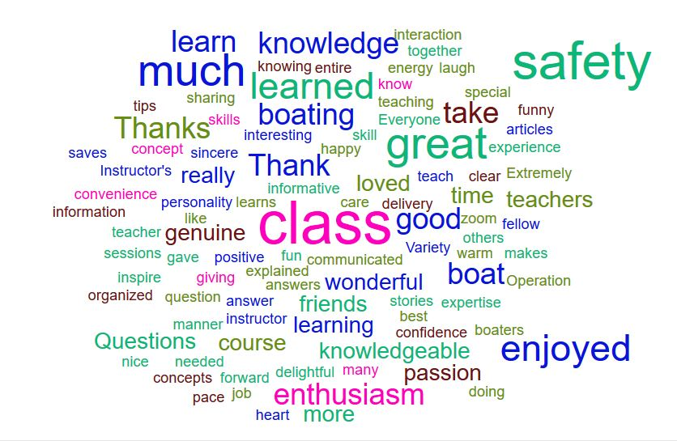
Post-Class

Slide 37
Post Class
Send FSO-HR Member Prospects
Ask class members to tell friends and family about classes

Slide 38
Kick-Starting Virtual/Video PE
Questions?

Slide 39
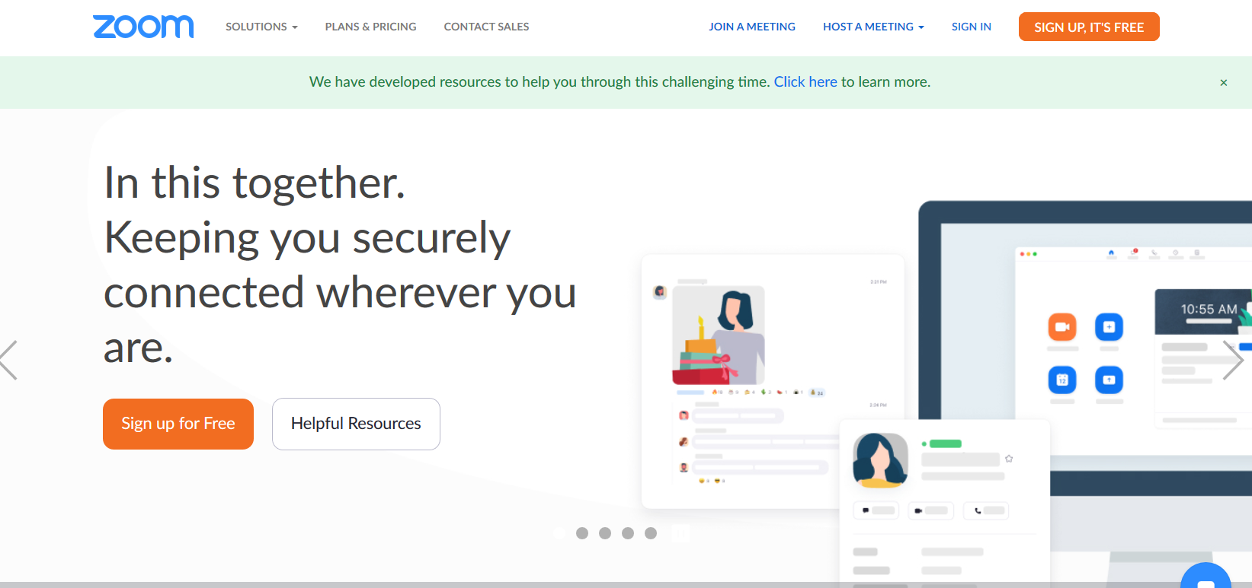
Zoom Info – The Basics

Slide 40
Set Up Virtual Platform
Zoom Pro Version
Set up your Personal Profile Select Calendar and Contact Integration
Set up your Personal Settings
Set up your Administrative Settings
Notes:
While the Auxiliary does not endorse any particular platform, the first classes have successfully been given using Zoom. Like any product, it can fall out of favor in the future for a number of reasons. Each flotilla should select their preferred platform.
Zoom PRO version offers our preferred platform. Unusually easy to set up, simple controls, share screen, co-host, and scale, best Gallery to see all participants, no bandwidth issues, designed specifically for teaching, students tend to be familiar due to academic, work and social use, affordable at $12.49 per month.
You can skip to next section if you are familiar with setting up Zoom and understand how to set up its Administrative Settings..

Slide 41
Set Up Virtual Platform
Schedule your Meetings
Send Calendar Invitations to Meetings
Familiarize/Play with Controls
Generate Reports Attendance Records
Notes:
While the Auxiliary does not endorse any particular platform, the first classes have successfully been given using Zoom. Like any product, it can fall out of favor in the future for a number of reasons. Each flotilla should select their preferred platform.
Zoom PRO version offers our preferred platform. Unusually easy to set up, simple controls, share screen, co-host, and scale, best Gallery to see all participants, no bandwidth issues, designed specifically for teaching, students tend to be familiar due to academic, work and social use, affordable at $12.49 per month.
You can skip to next section if you are familiar with setting up Zoom and understand how to set up its Administrative Settings..

Slide 42
Zoom Pro Version
Notes:
Review and understand the plan alternatives.
Basic is free up to 40 minutes. Unlimited number of meetings. All the basic features. Great plan – only limited by the 40 minutes to be free.
Pro offers all the Basic features and increases each meeting duration to 24 hours. Has cloud recording and other optional add-on plans.
Business offers all the Pro features and increases participants, adds dedicated phone support, and other features.
Enterprise offers all Business features and increases participants, unlimited cloud storage, dedicated customer service and bundle discounts.
Initial recommended consider using the features for Pro which you can begin to use gradually…Pro supports up to 9 hosts per plan and would seem to be suited for most Divisions, Flotillas or large MT/PE shops.

Slide 43
Set up your Personal Profile Select Calendar and Contact Integration
Notes:
Second step is to set up your FSO-PE personal profile.
It is critical to select Calendar and Contact Integration to allow you to maximize the power of this platform and save you serious time and administrative functions.
The second step is to set up the Administration. Most of us are used to our software being administered by others. Here we have the opportunity to set up the controls for ourselves. And they can be modified for different meetings. Admin is divided into the global controls in Admin and the specific meeting controls in Personal.
Zoom actually is very simply set up that a non-IT person can set it up. The secret is to carefully and deliberately consider each selection.
Control F6 search function is very helpful.
For the Account Profile - Recommend current professional CGAUX photo in Trop Blues and Be sure to select Calendar and Contact Integration.

Slide 44
Set up your Personal Settings
Notes:
Personal settings govern your individual meeting.
Again, go through them carefully keeping in mind the purpose of the meeting and your audience.
It is good practice to review them occasionally and always after upgrading Zoom versions in case there are default settings changes.

Slide 45
Set up your Administrative Settings
Notes:
Administrative settings control your global account settings.
Again, carefully review each choice keeping in mind your audience. It would take us about an hour to go through an in-depth discussion of each selection. It is very important to make these selections deliberately. The discussion around the selection of each option is actually very helpful in beginning to understand the multiple benefits and uses of this tool.
Passwords and Wait Room strongly recommended to control access.
Use the Tutorials and Knowledge base to learn more about your choices.

Slide 46
Schedule your Meetings
Notes:
You can schedule one or more meetings.
Select your hosting options and save…
New Meetings can be created at the moment or can be scheduled in advance.
To start an instant meeting simply start a meeting and send an invite to the individual(s).
To create a scheduled meeting, simply fill in the Schedule a Meeting page.
Click on Select New Meeting
Follow prompts
Select automatic Meeting ID and Meeting Password
Require meeting password
Meetings can be easily edited if necessary.
Avoid on the hour and half-hour scheduling to minimize rush hour crunch.
After you Save Meeting, the next screen will confirm your selections. You can edit or go on to select your preferred calendar option and proceed to fill that out.

Slide 47
Set Up Calendar Invitations to Meetings
Notes:
Use Google, Outlook or Yahoo Calendar choices to send your invitations to registered students.
This will greatly facilitate all contact with your students, from recording acceptance, sending updates, additional information and/or attachments, changes to schedule or class.
If a student does not use a calendar, they can still easily cut and paste from the invitation the same as they would from an email.
This is a most powerful tool: Select preferred calendar: Google, Outlook, Yahoo. Click on it.
Once on the calendar, add any specific comments and enter guest lists. Have Group lists prepared in your contacts.
The invitee will receive a Google/Yahoo/Outlook calendar appointment and should click respond to the invitation. Yes/No/Maybe.
That will record their answer and facilitate any reminders/follow-ups.
You will also have a copy of invitees readily available for your meeting.
Use the invitation to reinforce key messaging as well as mechanical aspects.
It does not matter if the recipient does not have or use a calendar; they will still receive the invitation with the information and can then note the meeting particulars in their own way.

Slide 48
Familiarize/Practice Controls
Screen: Full, Gallery, Speaker
Notes:
Time to Play…
Set up a test meeting with Co-host for the first time.
Set up someone else as a Co-Host at the start; this comes in very handy if the Host loses electricity or WiFi.
Practice controls.
Do a full dry run.
Bring out main controls from bottom or top of screen by hovering the mouse.
Hover the mouse over each symbol to see drop down/drop up menus; click and explore how each one works.
***Access to controls depends upon number of participants and to whom rights have been given*** Zoom is unusually flexible in that it allows simultaneous access.

Slide 49
Generate Reports/Attendance Records
Notes:
The reporting tools offer various alternatives by meetings, by users, by report.
This is accessible in CVS format and can be stored, sorted and used for reporting to NASBLA and other local state authorities.

Slide 50
Additional Resources for Starting Out
Zoom Set Up
E - Directorate
Download
Help Center
Getting Started
Quick Start
E- Directorate What’s New
Six Steps to Set Up
Best Learning Practices for Member Training and Public Education Classes
Checklist
Notes:
Zoom offers a rich array of tools to set up and run the platform.
There are also auxiliary specific additional resources:
D7 DIV6 is posting its training resources on its website and any D7 auxiliarists may access it simply by going to the website and logging into Training.
DIV6 at the request of the COL opened its classes to D7 SO-MTs. These classes may be seen on the DIV6 Training Calendar.
E-Directorate DSO-PEs are welcome to view these offerings. Please do not distribute further. If there is interest in Group Sessions, kindly find contact at the end.

Slide 51
ZOOM HELP CENTER
Zoom Help Center
offers a rich array of information on using its tools
Zoom Managing Participants
(https://www.youtube.com/watch?time_continue=89&v=ozJS9bvdVp8&feature=emb_logo)
Notes:
Rich variety of knowledge, tools, tips, etc….
Suggest accessing them regularly
Subscribe to their blog
Look up specific subject matters to get answers
Attend as many live meetings as you can…

Slide 52
Self-study
Notes:
This has been a high level summary to help to get you started. Keep taking classes.
Select the first two Getting Started with Zoom Meetings and Zoom Meetings.
Review them from a broad perspective.
Don’t get caught up in the details.
Take advantage of the other tutorials, webinars, etc.

Slide 53
Zoom – The Basics
Questions?

Slide 54
Marketing
Positioning
Referrals (Inbound) –
cultivate key sources of referrals at decision points in time
Publicity (Outbound) –
leverage traditional methods with repetitive messaging
Dedicated flotilla resources –
Focus individuals with specific tasking for regular follow up
4. FTF and Virtual approaches
Notes:
The purpose of this section is to share the various channels used by our flotillas as well as share some new ideas.
They cover both physical and virtual initiatives.
As a rule of thumb, Inbound marketing is most efficient and reliable.
Outbound marketing is the most traditional and complements inbound marketing but is not as effective.
Dedicated flotilla resources can make or break the marketing plan:
FSO- PE
FSO – PA
FSO-PB
FSO- VE
FSO-RBSVD
Face to Face can be strengthened immediately that FTF is resumed and should be cultivated for difficult times.
Virtual approaches can be created as driven by need.

Slide 55
Market Your Class
Our story - why students should take your video class and not other online classes
Referrals - how to cultivate key sources of steady referrals
Publicity - leverage ads, social media, etc.
Dedicate flotilla officers with specific tasking for regular follow up

Slide 56
Positioning ~ Intangible Benefits
Positioning –The positioning statement, slogan, pitch, must feature the advantages, the benefits that your classes offer over others.
Personal interactive conversations with experienced USCG Auxiliarists
Peace of mind when boating safely
Knowledge gained can prevent an accident, possibly serious
Comfort that boater is taking care of their family while out on the water
Good practices to prevent or handle emergencies (VHF)
Everyone in the family can learn together, enjoy together

Slide 57
Positioning ~ Tangible Benefits
No need to travel; convenience of home
Save time, round-trip, costs, parking
Safe environment
All inclusive leading to state certification; compliance for youth drivers
Possible lower insurance rates

Slide 58
Referrals (Inbound Marketing)
This pays off the best because it becomes a steady flow of students driven by their natural decision making at critical points.
The perfect time is when the boater is decision-making in any of the aspects of boating: buying, insuring, registering, events, renting, joining a boating organization, boat show time of the year, spring, fishing tournaments, etc.
BUT, it is critical that the referral be absolutely seamless for the referring party and the boater being referred.
Notes:
But it is a difficult mindset for us to get into because we are used to pushing out our messages.
Get into one or two sources of regular referrals by taping into their process with the boater.
The best time to reach the boater is when they are making a key decision about their boating…following are the main decision points and some suggestions for tapping into the process at the right time.

Slide 59
Referrals
Identify likely boat dealers in your area
Call on them by phone, set up Zoom meeting to talk
Explore setting up seamless referrals
Make contacts for follow up at local boat shows when FTF resumes
Join the local marine dealers association
Ask one flotilla mate to handle these relationships
when they buy a new/used boat…
…explore new/used boat dealers referrals
Notes:
This is an ideal time to reach out to our new/used dealer companies and offer to help to teach their clients.
They are struggling to recuperate and can use our help in educating their boaters, thus helping to get them out on the water safely, reducing risk and reducing insurance costs.
It is ideal for us because we will receive their referrals at a time when we are pivoting from classroom to video teaching and can benefit from referrals to help us to carry out our mission of educating the boating public.

Slide 60
Referrals
Identify most active local boat insurers
Call on them by phone, set up Zoom call
Explore setting up seamless referrals
Make contacts for follow up at your local boat shows
Ask one flotilla mate to support relationship
when they insure a boat …
…explore boating insurance company referrals
Notes:
Need to continue animation…

Slide 61
Referrals
Contact state boat registration offices to explore collaboration
Purchase state mailing list, capable of being sorted by categories
Create and maintain your boater’s data base
Direct mail campaign adjusted to your boating cycle in your state
when they register or renew their annual vessel registration …
…explore state boat registration resources

Slide 62
Referrals
Annual fishing tournaments offer visible opportunities to pitch classes
Email their participants
Table at their event
Speaker at their event
Present a Boating Safely Award
Recognize youngsters
Offer classes well in advance
Opportunities each year
fishing tournaments…
…explore with organizers well in advance of the event

Slide 63
Referrals
Great opportunity to
Offer classes
Set mind of boater for the future
When FTF resumes, call on each dealer in person during show – briefly – leave your business card – materials
Follow up with phone call
Pick up list of exhibitors for further mailings
boat shows…
…explore with organizers

Slide 64
Referrals
Many local rental companies, clubs, have a boating class requirement
Call on them personally to develop rapport and a steady flow of referrals
Make sure you offer your classes seamlessly, no friction
Follow up regularly to make sure they are satisfied
Cross-contact with their insurers for additional business
when they rent a boat…
…explore local rental companies

Slide 65
Referrals
Local sailing, yacht, boating clubs are a great source of annual students, especially in the spring
Families who are looking to boat together
Youngsters who prefer a known instructor
Commodores, marina managers, boating directors all welcome us
Call on them by phone, set up Zoom meeting to talk
when they join a boating organization…
…explore local sailing, yacht, boating clubs, dockmasters

Slide 66
Referrals
Marina managers typically welcome the Auxiliary
They can include our class information on their emails, postings, even mailings…
They are a source of information to their clients and we can be a referral for their boaters if we are top of mind…
Give us table space for displays in their offices…
when they go to renew their public marina slips…
…explore local marinas

Slide 67
Referrals
Local high schools typically need to offer information to their students that might help to keep them safe…while needed by as many students as Driver’s Ed, boating classes can be very valuable for those who do boat…
A simple announcement can go a long way
Can also reach parents with take home news
when their child turns of boating age…
…explore local high schools
Notes:
The summer is an ideal time to reach young people who need their state certification to go boating…
If school is out, perhaps the school administration office can suggest alternative ideas for contacting the students and letting them know of this opportunity.
Consider offering half price for those under 17..

Slide 68
Referrals
Most marine communities have charitable entities of one kind or another…
Approaching these for a conversation of mutual interest can generate ideas which can be translated into action resulting in support for our classes which in turn increase attendance…
when local charitable entities seek to support safe boating, clean marinas, etc. …
…explore boating safety, environmental foundations
Notes:
These activities continue, albeit at a modest rate, but this is the time to be creative and get in front of people who might be searching for fresh ideas to support safe boating, clean marinas, environment…etc.
A phone conversation cant hurt, especially if followed by a Zoom call to “meet” each other…
There is a phenomenon whereby people who Zoom feel a certain tie with each other although they have not met physically…

Slide 69
Referrals
Similarly, local businesses, including the local branches of national companies, are always looking to make donations to the community…
This can be in the form of publicity and/or monies…
If we follow Section H of the AUXMAN, certain funding can be obtained to support our classes…
when local businesses are looking to help the local community…
…explore annual donations from corporate community foundations (CVS, Publix …)

Slide 70
Publicity (Outbound Marketing )
Traditional outlets, including social media, rely on being seen at the right time by the buyer, and, also on being a source of education to the buyer.
These need to be frequent and top of mind to be effective.
PA can generate publicity, posters, positioning
PB can post on flotilla website and Facebook
RBSPV can distribute e-literature, brochures to focus groups
VE can distribute literature at the ramps with boaters
Notes:
Traditional mediums are not as focused but can still bring in students…
Use Print and Electronic…adapt medium as needed to the type of class…

Slide 71
Publicity
Community papers offer a great source of publicity…
Stories at the beginning of spring…
Public service ads…
Fun photographs of boating with reference to classes
when they read up on local current events…
…explore special interest articles with local community papers, social media

Slide 72
Publicity
Local TV news are always looking for positive news
Service Ads offer a good opportunity…
when they see you on the local TV news…
…get a local interview for the news

Slide 73
Publicity
Local radio offers a good variety…
Contact the key programs and offer to go on for a few minutes…
They are always looking for content…
when they hear you on the local radio boating, fishing programs…
…get local interviews

Slide 74
Publicity
~ Flotillas
Facebook
Dedicated PE webpage
National PE calendar
Ask students to repost on their social media pages
Ask flotilla members to repost on their social media pages
~National Publicity
–Update National website to incorporate virtual classes, references, etc.
~Calendar – 7023; Best to post as many classes as possible
Notes:
?

Slide 75
Calendar – 7023 Best to post as many classes as possible

Slide 76
Gallery View

Slide 77
Dedicated PE

Slide 78
Facebook Page

Slide 79
Close the Sale
Set up dedicated contact numbers and sites for classes
Personally respond to every call to register student
Dedicated Phone – PE class only
Dedicated Email – PE class only
Dedicated Website or webpage – PE class only
Dedicated Registration – PE class only
Notes:
Closing the sale is as important as generating inquiries and interest from prospective students.
The best way to make all the marketing pay off is to make sure to register each student who contacts us with interest. A “lost student” is an opportunity missed.
The personal handling of the prospective student will make the difference.

Slide 80
Marketing
Questions?

